Slide 1
Chapter 1
Computer Abstractions and Technology
Adapted version!
Dr. Agustin Laprovitta
alaprovitta@ucc.edu.ar
Notes:
Morgan Kaufmann Publishers
Chapter 1 — Computer Abstractions and Technology

Slide 2
The Computer Revolution
§1.1 Introduction
Progress in computer technology
  Underpinned by Moore’s Law
Makes novel applications feasible
  Computers in automobiles
  Cell phones
  Human genome project
  World Wide Web
  Search Engines
Computers are pervasive
Chapter 1 — Computer Abstractions and Technology — <number>
Notes:
Morgan Kaufmann Publishers
Chapter 1 — Computer Abstractions and Technology

Slide 3
Classes of Computers
Personal computers
  General purpose, variety of software
  Subject to cost/performance tradeoff
Server computers
  Network based
  High capacity, performance, reliability
  Range from small servers to building sized
Chapter 1 — Computer Abstractions and Technology — <number>
Notes:
Morgan Kaufmann Publishers
Chapter 1 — Computer Abstractions and Technology

Slide 4
Classes of Computers
Supercomputers
  High-end scientific and engineering calculations
  Highest capability but represent a small fraction of the overall computer market
Embedded computers
  Hidden as components of systems
  Stringent power/performance/cost constraints
Chapter 1 — Computer Abstractions and Technology — <number>

Slide 5
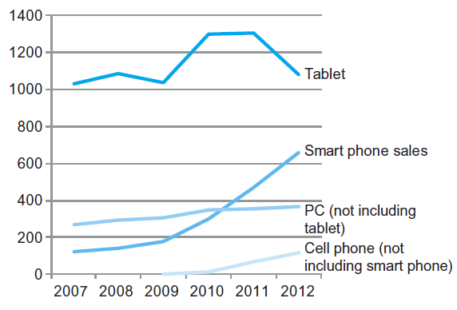
The PostPC Era
Chapter 1 — Computer Abstractions and Technology — <number>
Notes:
Morgan Kaufmann Publishers
Chapter 1 — Computer Abstractions and Technology

Slide 6
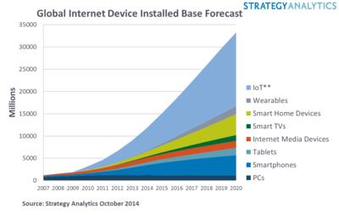
The PostPC Era
Chapter 1 — Computer Abstractions and Technology — <number>

Slide 7
Understanding Performance
Algorithm
  Determines number of operations executed
Programming language, compiler, architecture
  Determine number of machine instructions executed per operation
Processor and memory system
  Determine how fast instructions are executed
I/O system (including OS)
  Determines how fast I/O operations are executed
Chapter 1 — Computer Abstractions and Technology — <number>
Notes:
Morgan Kaufmann Publishers
Chapter 1 — Computer Abstractions and Technology

Slide 8








Eight Great Ideas
Design for Moore’s Law
Use abstraction to simplify design
Make the common case fast
Performance via parallelism
Performance via pipelining
Performance via prediction
Hierarchy of memories
Dependability via redundancy
§1.2 Eight Great Ideas in Computer Architecture
Chapter 1 — Computer Abstractions and Technology — <number>

Slide 9

Below Your Program
Application software
  Written in high-level language
System software
  Compiler: translates HLL code to machine code
  Operating System: service code
    Handling input/output
    Managing memory and storage
    Scheduling tasks & sharing resources
Hardware
  Processor, memory, I/O controllers
§1.3 Below Your Program
Chapter 1 — Computer Abstractions and Technology — <number>
Notes:
Morgan Kaufmann Publishers
Chapter 1 — Computer Abstractions and Technology

Slide 10
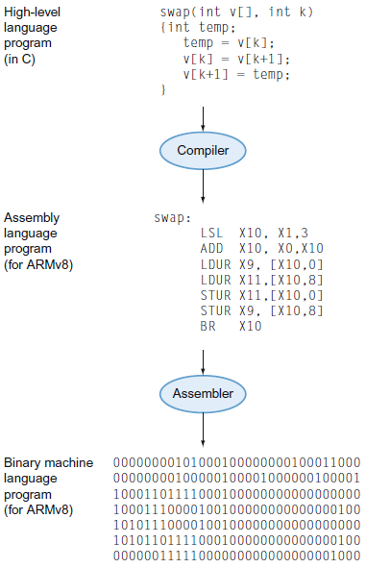
Levels of Program Code
High-level language
  Level of abstraction closer to problem domain
  Provides for productivity and portability
Assembly language
  Textual representation of instructions
Hardware representation
  Binary digits (bits)
  Encoded instructions and data
Chapter 1 — Computer Abstractions and Technology — <number>
Notes:
Morgan Kaufmann Publishers
Chapter 1 — Computer Abstractions and Technology

Slide 11

Components of a Computer
Same components for
all kinds of computer
  Desktop, server,
  embedded
Input/output includes
  User-interface devices
    Display, keyboard, mouse
  Storage devices
    Hard disk, CD/DVD, flash
  Network adapters
    For communicating with other computers
§1.4 Under the Covers
The BIG Picture
Chapter 1 — Computer Abstractions and Technology — <number>
Notes:
Morgan Kaufmann Publishers
Chapter 1 — Computer Abstractions and Technology

Slide 12

Manufacturing ICs
Yield: proportion of working dies per wafer
Chapter 1 — Computer Abstractions and Technology — <number>
Notes:
Morgan Kaufmann Publishers
Chapter 1 — Computer Abstractions and Technology

Slide 13

Intel Core i7 Wafer
300mm wafer, 280 chips, 32nm technology
Each chip is 20.7 x 10.5 mm
Chapter 1 — Computer Abstractions and Technology — <number>
Notes:
Morgan Kaufmann Publishers
Chapter 1 — Computer Abstractions and Technology

Slide 14

Integrated Circuit Cost
Nonlinear relation to area and defect rate
  Wafer cost and area are fixed
  Defect rate determined by manufacturing process
  Die area determined by architecture and circuit design
Chapter 1 — Computer Abstractions and Technology — <number>
Notes:
Morgan Kaufmann Publishers
Chapter 1 — Computer Abstractions and Technology

Slide 15




Defining Performance
§1.6 Performance
Which airplane has the best performance?
Chapter 1 — Computer Abstractions and Technology — <number>
Notes:
Morgan Kaufmann Publishers
Chapter 1 — Computer Abstractions and Technology

Slide 16
Response Time and Throughput
Response time
  How long it takes to do a task
Throughput
  Total work done per unit time
    e.g., tasks/transactions/… per hour
How are response time and throughput affected by
  Replacing the processor with a faster version?
  Adding more processors?
We’ll focus on response time for now…
Chapter 1 — Computer Abstractions and Technology — <number>
Notes:
Morgan Kaufmann Publishers
Chapter 1 — Computer Abstractions and Technology

Slide 17

Relative Performance
Define Performance = 1/Execution Time
“X is n time faster than Y”
Example: time taken to run a program
  10s on A, 15s on B
  Execution Time_{B} / Execution Time_{A}
  = 15s / 10s = 1.5
  So A is 1.5 times faster than B
Chapter 1 — Computer Abstractions and Technology — <number>
Notes:
Morgan Kaufmann Publishers
Chapter 1 — Computer Abstractions and Technology

Slide 18
Measuring Execution Time
Elapsed time
  Total response time, including all aspects
    Processing, I/O, OS overhead, idle time
  Determines system performance
CPU time
  Time spent processing a given job
    Discounts I/O time, other jobs’ shares
  Comprises user CPU time and system CPU time
  Different programs are affected differently by CPU and system performance
Chapter 1 — Computer Abstractions and Technology — <number>
Notes:
Morgan Kaufmann Publishers
Chapter 1 — Computer Abstractions and Technology

Slide 19
CPU Clocking
Operation of digital hardware governed by a constant-rate clock
Clock period
Clock (cycles)
Data transfer
and computation
Update state
Clock period: duration of a clock cycle
  e.g., 250ps = 0.25ns = 250×10^{–12}s
Clock frequency (rate): cycles per second
  e.g., 4.0GHz = 4000MHz = 4.0×10⁹Hz
Chapter 1 — Computer Abstractions and Technology — <number>
Notes:
Morgan Kaufmann Publishers
Chapter 1 — Computer Abstractions and Technology

Slide 20

CPU Time
Performance improved by
  Reducing number of clock cycles
  Increasing clock rate
  Hardware designer must often trade off clock rate against cycle count
Chapter 1 — Computer Abstractions and Technology — <number>
Notes:
Morgan Kaufmann Publishers
Chapter 1 — Computer Abstractions and Technology

Slide 21

CPU Time Example
Computer A: 2GHz clock, 10s CPU time
Designing Computer B
  Aim for 6s CPU time
  Can do faster clock, but causes 1.2 × clock cycles
How fast must Computer B clock be?
Chapter 1 — Computer Abstractions and Technology — <number>
Notes:
Morgan Kaufmann Publishers
Chapter 1 — Computer Abstractions and Technology

Slide 22

Instruction Count and CPI
Instruction Count for a program
  Determined by program, ISA and compiler
Average cycles per instruction
  Determined by CPU hardware
  If different instructions have different CPI
    Average CPI affected by instruction mix
Chapter 1 — Computer Abstractions and Technology — <number>
Notes:
Morgan Kaufmann Publishers
Chapter 1 — Computer Abstractions and Technology

Slide 23

CPI Example
Computer A: Cycle Time = 250ps, CPI = 2.0
Computer B: Cycle Time = 500ps, CPI = 1.2
Same ISA
Which is faster, and by how much?
A is faster…
…by this much
Chapter 1 — Computer Abstractions and Technology — <number>
Notes:
Morgan Kaufmann Publishers
Chapter 1 — Computer Abstractions and Technology

Slide 24
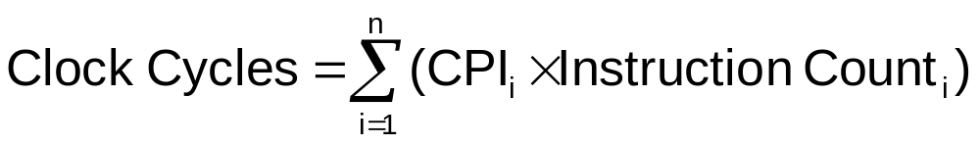

CPI in More Detail
If different instruction classes take different numbers of cycles
Weighted average CPI
Relative frequency
Chapter 1 — Computer Abstractions and Technology — <number>
Notes:
Morgan Kaufmann Publishers
Chapter 1 — Computer Abstractions and Technology

Slide 25
CPI Example
Alternative compiled code sequences using instructions in classes A, B, C
Class | A | B | C
CPI for class | 1 | 2 | 3
IC in sequence 1 | 2 | 1 | 2
IC in sequence 2 | 4 | 1 | 1
Sequence 1: IC = 5
  Clock Cycles
  = 2×1 + 1×2 + 2×3
  = 10
  Avg. CPI = 10/5 = 2.0
Sequence 2: IC = 6
  Clock Cycles
  = 4×1 + 1×2 + 1×3
  = 9
  Avg. CPI = 9/6 = 1.5
Chapter 1 — Computer Abstractions and Technology — <number>
Notes:
Morgan Kaufmann Publishers
Chapter 1 — Computer Abstractions and Technology

Slide 26

Performance Summary
The BIG Picture
Performance depends on
  Algorithm: affects IC, possibly CPI
  Programming language: affects IC, CPI
  Compiler: affects IC, CPI
  Instruction set architecture: affects IC, CPI, T_{c}
Chapter 1 — Computer Abstractions and Technology — <number>
Notes:
Morgan Kaufmann Publishers
Chapter 1 — Computer Abstractions and Technology

Slide 27

Power Trends
§1.7 The Power Wall
In CMOS IC technology
×30
5V → 1V
×1000
Chapter 1 — Computer Abstractions and Technology — <number>
Notes:
Morgan Kaufmann Publishers
Chapter 1 — Computer Abstractions and Technology

Slide 28

Reducing Power
Suppose a new CPU has
  85% of capacitive load of old CPU
  15% voltage and 15% frequency reduction
The power wall
  We can’t reduce voltage further
  We can’t remove more heat
How else can we improve performance?
Chapter 1 — Computer Abstractions and Technology — <number>
Notes:
Morgan Kaufmann Publishers
Chapter 1 — Computer Abstractions and Technology

Slide 29
Non(?)-Conventional Architectures
With Intel and its x86 architecture (early 80’s) comes the term “conventional architecture”
CISC (Intel) vs. RISC (ARM & rest of the world)
  CISC: Complex Instruction Set-Computer
  RISC: Reduced Instruction Set-Computer
Origin:
  Berkeley University (Patterson - 1980): RISC Project
    Performance via register oriented instruction
  Stanford University (Hennessy - 1981): MIPS Project
    Performance via segmentation (pipeline)
Chapter 1 — Computer Abstractions and Technology — <number>

Slide 30
RISC characteristics
One intruction per cycle (CPI = 1)
  … or constant intruction cycle
Reg-to-Reg operation oriented
  Dedicated memory access instructions
  Large number of general-purpose registers
Simple addressing modes
  Ideally, just one!.... But…
Simple instruction formats
Reduce instruction set (ponele…)
Chapter 1 — Computer Abstractions and Technology — <number>

Slide 31
ARM & MIPS Similarities
ARM: the most popular embedded core
Similar basic set of instructions to MIPS
§2.16 Real Stuff: ARM Instructions
 | ARM | MIPS
Date announced | 1985 | 1985
Instruction size | 32 bits | 32 bits
Address space | 32-bit flat | 32-bit flat
Data alignment | Aligned | Aligned
Data addressing modes | 9 | 3
Registers | 15 × 32-bit | 31 × 32-bit
Input/output | Memory mapped | Memory mapped
Chapter 2 — Instructions: Language of the Computer — <number>
Notes:
The University of Adelaide, School of Computer Science
Chapter 2 — Instructions: Language of the Computer

Slide 32
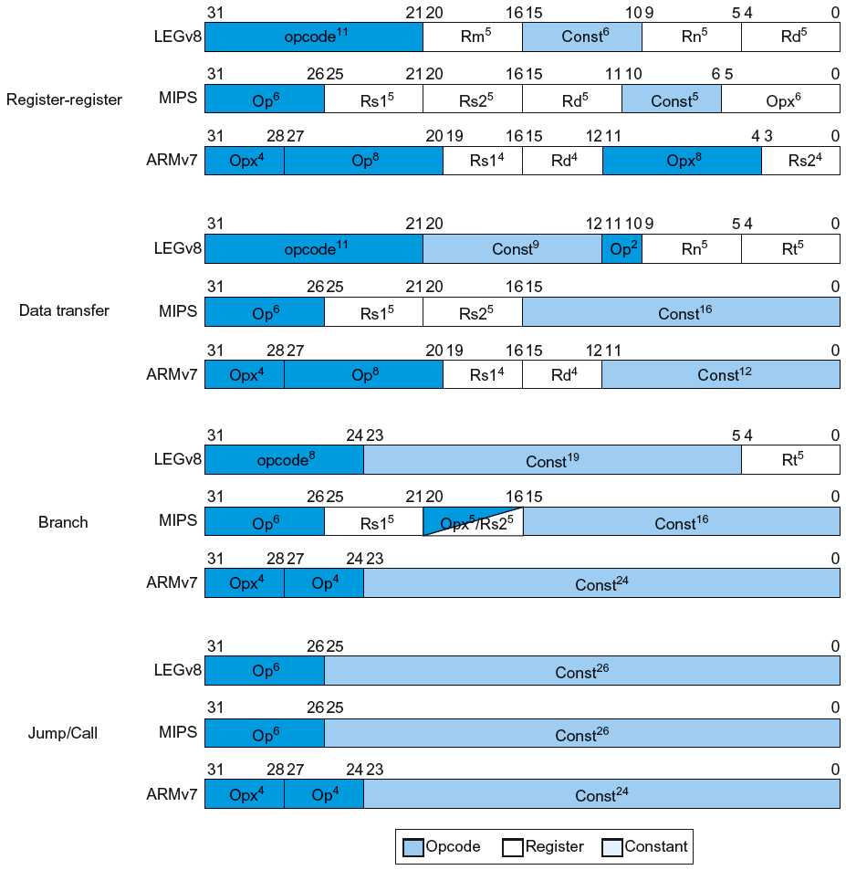
Instruction Encoding
Chapter 2 — Instructions: Language of the Computer — <number>
Notes:
The University of Adelaide, School of Computer Science
Chapter 2 — Instructions: Language of the Computer

Slide 33
The Intel x86 ISA
Evolution with backward compatibility
  8080 (1974): 8-bit microprocessor
    Accumulator, plus 3 index-register pairs
  8086 (1978): 16-bit extension to 8080
    Complex instruction set (CISC)
  8087 (1980): floating-point coprocessor
    Adds FP instructions and register stack
  80286 (1982): 24-bit addresses, MMU
    Segmented memory mapping and protection
  80386 (1985): 32-bit extension (now IA-32)
    Additional addressing modes and operations
    Paged memory mapping as well as segments
§2.17 Real Stuff: x86 Instructions
Chapter 2 — Instructions: Language of the Computer — <number>
Notes:
The University of Adelaide, School of Computer Science
Chapter 2 — Instructions: Language of the Computer

Slide 34
The Intel x86 ISA
Further evolution…
  i486 (1989): pipelined, on-chip caches and FPU
    Compatible competitors: AMD, Cyrix, …
  Pentium (1993): superscalar, 64-bit datapath
    Later versions added MMX (Multi-Media eXtension) instructions
    The infamous FDIV bug
  Pentium Pro (1995), Pentium II (1997)
    New microarchitecture (see Colwell, The Pentium Chronicles)
  Pentium III (1999)
    Added SSE (Streaming SIMD Extensions) and associated registers
  Pentium 4 (2001)
    New microarchitecture
    Added SSE2 instructions
Chapter 2 — Instructions: Language of the Computer — <number>
Notes:
The University of Adelaide, School of Computer Science
Chapter 2 — Instructions: Language of the Computer

Slide 35
The Intel x86 ISA
And further…
  AMD64 (2003): extended architecture to 64 bits
  EM64T – Extended Memory 64 Technology (2004)
    AMD64 adopted by Intel (with refinements)
    Added SSE3 instructions
  Intel Core (2006)
    Added SSE4 instructions, virtual machine support
  AMD64 (announced 2007): SSE5 instructions
    Intel declined to follow, instead…
  Advanced Vector Extension (announced 2008)
    Longer SSE registers, more instructions
If Intel didn’t extend with compatibility, its competitors would!
  Technical elegance ≠ market success
Chapter 2 — Instructions: Language of the Computer — <number>
Notes:
The University of Adelaide, School of Computer Science
Chapter 2 — Instructions: Language of the Computer

Slide 36

Basic x86 Registers
Chapter 2 — Instructions: Language of the Computer — <number>
Notes:
The University of Adelaide, School of Computer Science
Chapter 2 — Instructions: Language of the Computer

Slide 37
Basic x86 Addressing Modes
Two operands per instruction
Source/dest operand | Second source operand
Register | Register
Register | Immediate
Register | Memory
Memory | Register
Memory | Immediate
Memory addressing modes
  Address in register
  Address = R_{base} + displacement
  Address = R_{base} + 2^{scale} × R_{index} (scale = 0, 1, 2, or 3)
  Address = R_{base} + 2^{scale} × R_{index} + displacement
Chapter 2 — Instructions: Language of the Computer — <number>
Notes:
The University of Adelaide, School of Computer Science
Chapter 2 — Instructions: Language of the Computer

Slide 38
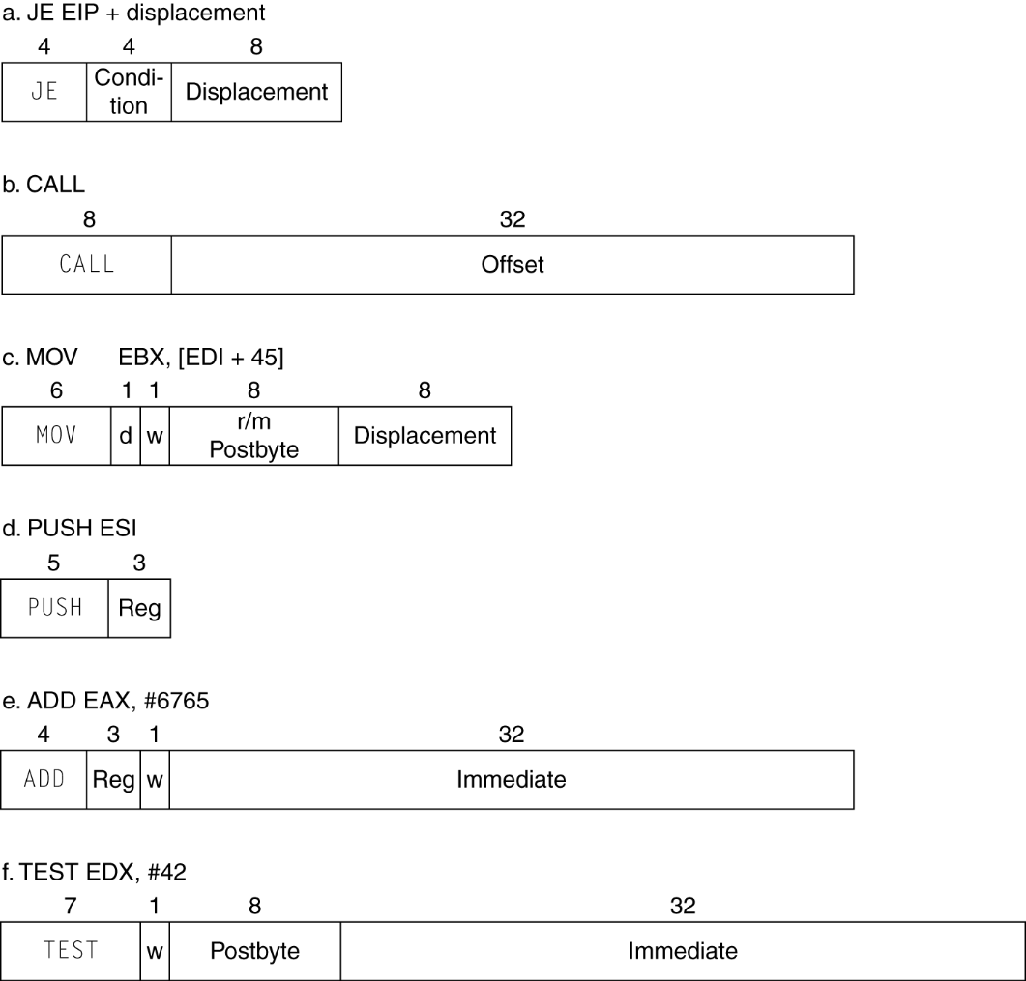
x86 Instruction Encoding
Variable length encoding
  Postfix bytes specify addressing mode
  Prefix bytes modify operation
    Operand length, repetition, locking, …
Chapter 2 — Instructions: Language of the Computer — <number>
Notes:
The University of Adelaide, School of Computer Science
Chapter 2 — Instructions: Language of the Computer

Slide 39
Implementing IA-32
Complex instruction set makes implementation difficult
  Hardware translates instructions to simpler microoperations
    Simple instructions: 1–1
    Complex instructions: 1–many
  Microengine similar to RISC
  Market share makes this economically viable
Comparable performance to RISC
  Compilers avoid complex instructions
Chapter 2 — Instructions: Language of the Computer — <number>
Notes:
The University of Adelaide, School of Computer Science
Chapter 2 — Instructions: Language of the Computer

Slide 40
Fallacies
Powerful instruction ⇒ higher performance
  Fewer instructions required
  But complex instructions are hard to implement
    May slow down all instructions, including simple ones
  Compilers are good at making fast code from simple instructions
Use assembly code for high performance
  But modern compilers are better at dealing with modern processors
  More lines of code ⇒ more errors and less productivity
§2.19 Fallacies and Pitfalls
Chapter 2 — Instructions: Language of the Computer — <number>
Notes:
The University of Adelaide, School of Computer Science
Chapter 2 — Instructions: Language of the Computer

Slide 41

Fallacies
Backward compatibility ⇒ instruction set doesn’t change
  But they do accrete more instructions
x86 instruction set
Chapter 2 — Instructions: Language of the Computer — <number>
Notes:
The University of Adelaide, School of Computer Science
Chapter 2 — Instructions: Language of the Computer

